Slide 1
Unit 3 Software Project Planning

Slide 2
Overview
Software planning involves estimating how much time, effort, money, and resources will be required to build a specific software system. After the project scope is determined and the problem is decomposed into smaller problems, software managers use historical project data (as well as personal experience and intuition) to determine estimates for each. The final estimates are typically adjusted by taking project complexity and risk into account. The resulting work product is called a project management plan.

Slide 3
Project Planning Objectives
To prevent obstacles that arise in the project such as changes in projects or organization's objectives, non-availability of resources, and so on.
better utilization of resources and optimal usage of the allotted time for a project,
To define the roles and responsibilities of the project management team members.
To ensure that the project management team works according to the business objectives.
To check feasibility of the schedule and user requirements.
To determine project constraints.

Slide 4
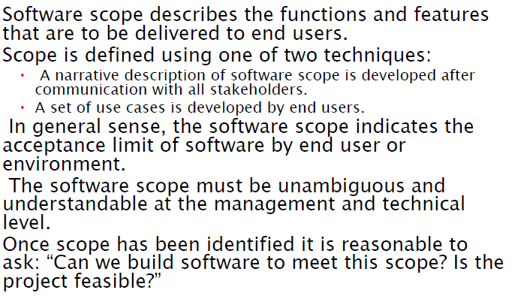
Software Scope

Slide 5
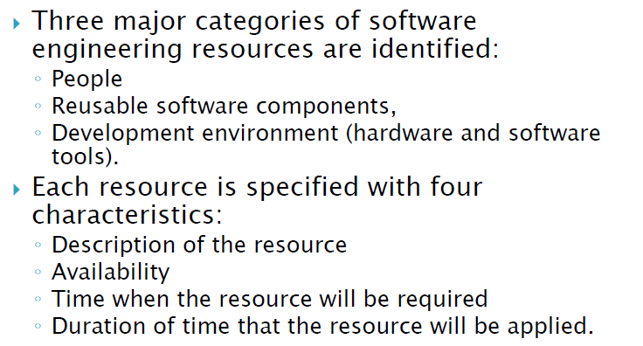
Resources

Slide 6
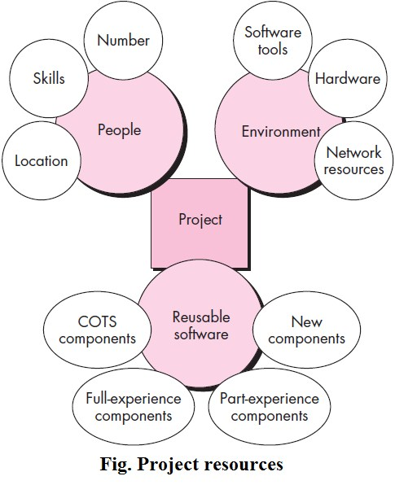

Slide 7
A.Human Resources
Human are the primary resources that evaluate software scope and select the skills required to complete development. They specify both organizational position (e.g., manager, senior software engineer) and specialty (e.g,telecommunications, database, and client-server).
The number of people required for a software project can be determined only after an estimate of development effort (e.g., person-months) is made.
For relatively small projects (a few person-months), a single individual may perform all software engineering tasks, consulting with specialists as required.
For larger projects, the software team may be geographically dispersed across a number of different locations. Hence, the location of each human resource is specified.

Slide 8
B. Reusable Software Resources
Component-based software engineering (CBSE) emphasizes reusability—that is, the creation and reuse of software building blocks. Such building blocks, often called components, must be cataloged for easy reference, standardized for easy application, and validated for easy integration
Bennatan suggests four software resource categories that should be considered as planning proceeds:
Off-the-shelf components: Existing software that can be acquired from a third party or from a past project. COTS (commercial off-the-shelf) components are purchased from a third party, are ready for use on the current project, and have been fully validated.

Slide 9
Full-experience components: Existing specifications, designs, code, or test data developed for past projects that are similar to the software to be built for the current project. Members of the current software team have had full experience in the application area represented by these components. Therefore, modifications required for full-experience components will be relatively low risk.
Partial-experience components: Existing specifications, designs, code, or test data developed for past projects that are related to the software to be built for the current project but will require substantial modification. Members of the current software team have only limited experience in the application area represented by these components. Therefore, modifications required for partial-experience components have a fair degree of risk.
New components: Software components must be built by the software team specifically for the needs of the current project.

Slide 10
C. Environmental Resources
The environment that supports a software project, often called the software engineering environment (SEE), incorporates hardware and software.
Hardware provides a platform that supports the tools (software) required to produce the work products that are an outcome of good software engineering practice.
When a computer-based system (incorporating specialized hardware and software) is to be engineered, the software team may require access to hardware elements being developed by other engineering teams. For example, software for a robotic device may require a specific robot as part of the validation test step.

Slide 11
Software Project Estimation
Today the software is the most expensive element of all computer system and the large cost estimation error can make the difference between the profit and loss.
Software cost and effort estimation will never be an exact science.
Too many variables—human, technical, environmental, political—can affect the ultimate cost of software and effort applied to develop it.
However, software project estimation can be transformed from a black art to a series of systematic steps that provide estimates with acceptable risk.

Slide 12
To achieve reliable cost and effort estimates, a number of options arise:
The cost due to late in the project.
The cost of previous similar project must be analyzed.
Use relatively simple decomposition techniques to generate project cost and effort estimates. Such decomposition techniques may be LOC-based estimation, FP-based estimation, Process based estimation, Estimation with use case etc.
Use one or more empirical models (like COCOMO II) for software cost and effort estimation.

Slide 13
Decomposition techniques
Software project estimation is a form of problem solving, and in most cases, the problem to be solved (i.e. developing a cost and effort estimate for a software project) is too complex to be considered in one piece. For this reason, we should decompose the problem, re-characterizing it as a set of smaller (and hopefully, more manageable) problems.
The decomposition approach was discussed from two different points of view: decomposition of the problem and decomposition of the process. Estimation uses one or both forms of partitioning. But before an estimate can be made, the project planner must understand the scope of the software to be built and generate an estimate of its “size.”

Slide 14
A. Software Sizing
The accuracy of software project estimation is depends on:
The size of product to be built.
The human effort, calendar time, and availability of reusable software components.
The ability and experience of the software team.
The stability of the product requirements and the supporting environments.

Slide 15

B.Problem-Based Estimation
The expected value for the estimation variable (S) can be computed as a weighted average of the optimistic (s_{opt}), most likely (s_{m}), and pessimistic (s_{pess}) estimates. The estimated value may be of LOC or FP estimation techniques.

Slide 16
Software measurement
Direct measure: Direct measure of software process includes cost and effort applied which are easier to measure by person-month analysis. Also, it includes line of code (LOC) produced, execution speed, memory size and defects reported over some set period of time.
Indirect measure: Indirect measures of the product include functionality, quality, complexity, efficiency, reliability, maintenance possibilities, usability, portability, etc. They are relatively difficult to measure.

Slide 17
Line of code (LOC) measurement
LOC is simplest way to estimate the project size among all metrics available
To find the LOC at the beginning of a project, divide module into sub-module and so on, until size of each module can be predicted
The project size estimation by counting the number of source instruction is an ambiguous task because there may have multiple lines of code used for commenting, header lines of codes etc.
Thus, a commonly adopted convention is to count only the lines of codes that are delivered to the customers as part of the product.

Slide 18
Line of code (LOC) limitation
The LOC will vary according to programming style i.e. complex logic may reduce some codes by the replacement of the simple logic.
The reuse of codes will vary the program size.
There may not be better quality on large sized programs.
The accurate LOC are only computed after project completion.
On project estimation, the software product not only depends on the LOC but this may vary due to analysis, design, testing etc.

Slide 19
Example
If
Estimated total LOC on any project = 33,200
Organizational average productivity = 620 LOC/pm
Labor rate per month = $8000
Then,
Cost per LOC = ($8000/m)/(620LOC/pm) = $13
Total project cost = Total LOC x Cost per LOC = 33,200 x $13 = $4,31,600
Estimated effort = Total LOC / Average productivity
= (33,200 LOC) / (620 LOC/person month) = 54 persons

Slide 20
Function based metric (FP)
The function point (FP) metric can be used effectively as a means for measuring the functionality delivered by a system. Using historical data, the FP metric can be used to:
Estimate the cost or effort required to design, code and test the software
Predict the number of errors that will be encounter during testing.
Forecast the number of components in implemented system.

Slide 21
Function points are derived using an empirical relationship based on countable (direct) measures of software’s information domain (UFP) and qualitative assessments of software complexity (TCF). Information domain values are defined in the following manner:
Number of external inputs (EIs) (weight-4): Each external input originates from a user or is transmitted from another application and provides distinct application-oriented data or control information. Inputs are often used to update internal logical files (ILFs). Inputs should be distinguished from inquiries, which are counted separately.
Number of external outputs (EOs) (weight-5): Each external output is derived data within the application that provides information to the user. In this context external output refers to reports, screens, error messages, etc. Individual data items within a report are not counted separately.

Slide 22
Number of external inquiries (EQs) (weight-4): An external inquiry is defined as an online input that results in the generation of some immediate software response in the form of an online output (often retrieved from an ILF).
Number of internal logical files (ILFs) (weight-10): Each internal logical file is a logical grouping of data that resides within the application’s boundary and is maintained via external inputs.
Number of external interface files (EIFs) (weight-10): Each external interface file is a logical grouping of data that resides external to the application but provides information that may be of use to the application.

Slide 23
Function point (FP) = Unadjusted function point (UFP) x Technical complexity factor (TCF)
Where,
UPF = Input x 4 + output x 5 + Inquiries x 4 + Files x 10 + Interface x 10
TCF (varies from 0.65 to 1.35) = 0.65 + 0.01 x Degree of influence (DI)
DI = Number of questions x weight to each question = 14 x (0 to 5) = ∑ (F_{i})]
Thus, FP = UFP x [0.65 x 0.01 x ∑ (Fi)]

Slide 24
The F_{i} (i = 1 to 14) is value adjustment factors (VAF) based on responses to the following questions:
Does the system require reliable backup and recovery?
Are specialized data communications required to transfer information to or from the application?
Are there distributed processing functions?
Is performance critical?
Will the system run in an existing, heavily utilized operational environment?
Does the system require online data entry?
Does the online data entry require the input transaction to be built over multiple screens or operations?
Are the ILFs updated online?
Are the inputs, outputs, files, or inquiries complex?
Is the internal processing complex?
Is the code designed to be reusable?
Are conversion and installation included in the design?
Is the system designed for multiple installations in different organizations?
Is the application designed to facilitate change and ease of use by the user?

Slide 25
Each of these questions is answered using a scale that ranges from 0 (not important or applicable) to 5 (absolutely essential). Note that, if these all 14 technical questions have given the average value (3), then TCF = 0.65 + 0.01 x (14x3) = 1.07.
For example: If FP =UFP x TCF = 375 FP, average productivity = 6.5 FP/PM and labor rate = $8000 per month then
Cost per FP = ($8000) / (6.5 FP/PM) = $1230
Total project cost = 375 x $1230 = $461250
Estimated effort = Total FP / Average productivity = 375 FP / (6.5 FP/PM) = 58 persons

Slide 26
C. Empirical estimation models
An estimation model reflects the population of projects from which it has been derived. Therefore, the model is domain sensitive.
An estimation model for computer software uses empirically derived formulas to predict effort as a function of LOC or FP.

Slide 27
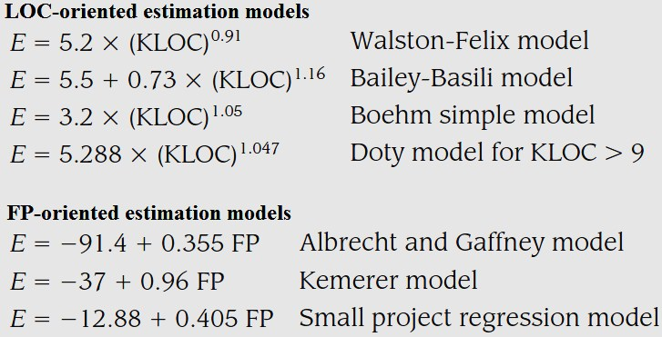
The Structure of Estimation Models
A typical estimation model is derived using regression analysis on data collected from past software projects. The overall structure of such models takes the form: E =A + B x (e_{v})^{C}, where A, B, and C are empirically derived constants, E is effort in person-months, and e_{v}is the estimation variable (either LOC or FP).

Slide 28
Homework:
Explain COCOMO model.(focus on COCOMO II)

Slide 29
Software Risk
Risk concerns the future happening that always involves two characteristics:
uncertainty— the risk may or may not happen; that is, and
loss—if the risk becomes a reality, unwanted losses will occur. When risks are analyzed, it is important to quantify the level of uncertainty and the degree of loss associated with each risk

Slide 30
Categories of risks(Types)
1. Project risk: Threaten the project plan.
Project risks identify potential budgetary, schedule, personnel (staffing and organization), resource, stakeholder, and requirements problems and their impact on a software project.
2. Technical risks: threaten the quality and timeliness
Technical risks identify potential design, implementation, interface, verification, and maintenance problems. In addition, specification ambiguity, technical uncertainty are also risk factors. Technical risks occur because the problem is harder to solve than expected.

Slide 31
3. Business risks: threaten the feasibility
It includes the top five business risks which are
a. Market risk: system that no one really wants
b. Strategic risk: product no longer fits into the overall business strategy
c. Sales risk: the sales force doesn’t understand how to sell the product
d. Management risk: losing the support of senior management
e. Budget risks: losing budgetary or personnel commitment
4. Known risks
Risk that can be uncovered after careful evaluation of the project plan, the business and technical environment in which the project is being developed, and other reliable information sources (e.g., unrealistic delivery date, lack of documented requirements or software scope, poor development environment).
5. Predictable risks
These risks are identified from past project experience (e.g., staff turnover, poor communication with the customer, dilution of staff effort as ongoing maintenance requests are serviced).
6. Unpredictable risks
They can and do occur, but they are extremely difficult to identify in advance.

Slide 32
Risk Identification
Risk identification is a systematic attempt to specify threats to the project plan (estimates, schedule, resource loading, etc.). By identifying known and predictable risks, the project manager takes a first step toward avoiding them when possible and controlling them when necessary. The different categories of risk (project, technical, business, known, predictable, and unpredictable) can be further divided as:
a. Generic risks: They are a potential threat to every software project.
b. Product-specific risks: They can be identified only by those with a clear understanding of the technology, the people, and the environment that is specific to the software that is to be built. To identify product-specific risks, the project plan and the software statement of scope are examined, and analyze the special characteristics of any product that may threaten the project plan.

Slide 33
Method for identifying risks
By creating a risk item checklist; we need to identify the following area from where risk will appear
Product size—risks associated with the overall size of the software to be built or modified.
Business impact—risks associated with constraints imposed by management or the marketplace.
Stakeholder characteristics—risks associated with the sophistication of the stakeholders and the developer’s ability to communicate with stakeholders in a timely manner.

Slide 34
Process definition—risks associated with the degree to which the software process has been defined and is followed by the development organization.
Development environment—risks associated with the availability and quality of the tools to be used to build the product.
Technology to be built—risks associated with the complexity of the system to be built and the “newness” of the technology that is packaged by the system.
Staff size and experience—risks associated with the overall technical and project experience of the software engineers who will do the work.

Slide 35
Risk Projection
Risk projection, also called risk estimation, attempts to rate each risk in two ways—
the likelihood or probability that the risk is real and
the consequences of the problems associated with the risk, should it occur.

Slide 36
Risk projection Technique
A risk table provides a simple technique for risk projection. The risk table can be implemented as a spreadsheet model. This enables easy manipulation and sorting of the entries. Here, at first all risks are listed in the first column of the table. This can be accomplished with the help of the risk item checklists reference. Each risk is categorized in the second column. The probability of occurrence of each risk is entered in the next column of the table. The probability value for each risk can be estimated by team members individually.

Slide 37
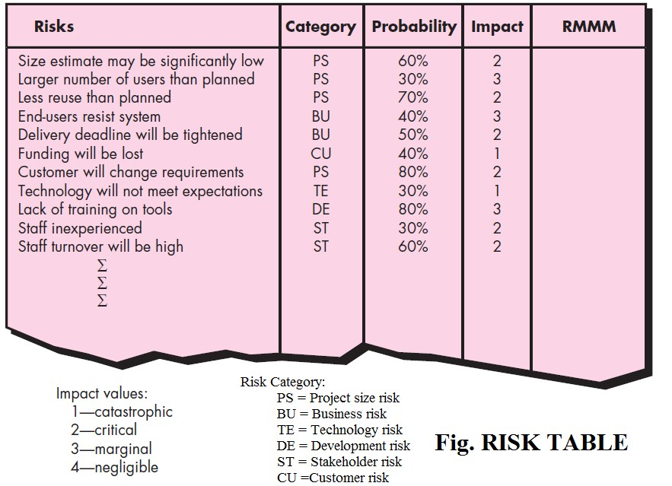

Slide 38
Finally, the table is sorted by probability and by impact. High-probability, high-impact risks percolate to the top of the table, and low-probability risks drop to the bottom. This accomplishes first-order risk prioritization. After that the table is sorted and defines a cutoff line. The cutoff line (drawn horizontally at some point in the table) implies that only risks that lie above the line will be given further attention. Risks that fall below the line are reevaluated to accomplish second-order prioritization

Slide 39
Important numerical for risk exposure calculation
Only 70 percent of the software components scheduled for reuse will be integrated into the application.
•The remaining functionality will have to be custom developed.•Risk probability. 80% (likely).
•60 reusable software components were planned.
•(total no. of components = 60, 70% can be reused.
Components to be developed = total – reuse = 60 – 42 = 18 No. of components to be used =? [from total no. of components ]= 60* 70% can be reused= 60*0.7 = 42 …..> reuse)
•If only 70 percent can be used, 18 components would have to be developed from scratch (in addition to other custom software that has been scheduled for development).
•Since the average component is 100 LOC and local data indicate that the software engineering cost for each LOC is $14.00, the overall cost (impact) to develop the components would be 18 x 100 x 14 = $25,200.
•Risk exposure. RE = 0.80 x 25,200 ~ $20,200.

